Slide 1
“TO STUDY COMPARATIVE ANALYSIS ON THE BASIS OF COMPETITION DRIVE BETWEEN TOP OUTLETS IN SHRIRAMPUR REGION.”
PROJECT TITLE
Name: Kokane Akash Rajendra
Under the guidance of: Dr. N.N. Dighe Sir

Slide 2
INDUSTRY & ORGANIZATION PROFILE
Fast-moving consumer goods (FMCG) sector is India’s fourth-largest sector and has been expanding at a healthy rate over the years as a result of rising disposable income, a rising youth population, and rising brand awareness among consumers. With household and personal care accounting for 50% of FMCG sales in India, the industry is an important contributor to India’s GDP.
India is a country that no FMCG player can afford to ignore due to its middle-class population which is larger than the total population of USA. The Indian FMCG market continues to rise as more people start to move up the economic ladder and the benefits of economic progress become accessible to the general public

Slide 3
OUTLINE OF PROJECT/TASK UNDERTAKEN
Purpose of the research study:
To know the different strategies of competitors regarding pay-outs given to top outlets in the region of Shrirampur.
To know what are the parameters on which the pay-outs is being claim by top outlets.
To know the top outlets perception towards ITC on the basis of Pay outing, Target communication, Auditor Info & Visual Display.

Slide 4
This project is carried out with intention of knowing how are competitors competing in the market with regarding top outlets. What are the different strategies carried out by them, on what basis the pay-outs are been given to these outlets, are there any special schemes offered to them by different companies. Through this researcher can be able to interpret the data & able to derive best possible outcome to compete in the market. Thus, this project carries it’s important to make the difference in marketing strategies.
Researcher have conducted interviews of 19 top outlets owners in Shrirampur region. Through those interviews I have landed upon below mentioning findings.
Companies like Britannia, Nestle, HUL do give pay-outs when targets are achieved but Parle doesn’t give pay-outs but offers better schemes/margin than ordinary outlets to these top outlets.

Slide 5
Target communication is done meanly with Mobile App & SMS, target communication with invoice is not carried out by most pf the companies except Cadbury.
Most of the pay-outs are given on the basis of shelves then that of End caps, Racks etc.
Through the study there are some suggestions which I would like to share with ITC ltd:
Target communication with top outlets like Groceries & Bakeries should be improved, these outlets are not aware about their targets.
ITC should focus more on product offerings & visual displays which will help in brand awareness among the customers coming into these outlets.
Proper guidance should be given to these outlets about Unnati app so that awareness about different information about products can be known by them.

Slide 6
OBJECTIVES OF THE STUDY:
To study impact of display advertising strategies of different companies in top outlets.
To study impact of pay-outs on sales of product in top outlets.
To study product offerings of different companies in top outlets.
To study retailer perception towards ITC in top outlets.

Slide 7
RESEARCH METHODOLOGY
RESEARCH DESIGN:
Descriptive research:
Def: Descriptive research is defined as a “research method that describes the characteristics of the population or phenomenon studied. This descriptive methodology focuses more on the “what” of the research subject than the “why” of the research subject. “
Thus, going through research, researcher wanted to understand what competition drive was focused by different companies in Top Outlets in Shrirampur region. The reason behind the research was to know the what other companies were doing so that ITC would work on it and improve. This was done through keeping descriptive research design in mind.

Slide 8
Exploratory research:
Def: In this type of research, researchers try to uncover the hidden and unknown facts and phenomena. This kind of research is helpful in exploring the information for problems which have not been defined precisely. It is also called as formulative research. It tries to answer the questions with appropriate reasons.
Thus, going through research & after having the conversation with owners of these top outlets research came to know about lots on unknown facts & problems on the basis of pay-outs & target communications through use of exploratory research design.

Slide 9
SAMPLE DESIGN:
Sample Size:
For the statistical data researcher did survey of 19 top outlets through circulating Questioners.
Sample Population:
For the Survey of research, researcher focused on owners of top outlets or in charged person for responses.
Sample Area:
For the survey of research, researcher focused on the top outlets within the Shrirampur region
Sample Technique:
Researcher has taken Stratified Random Sampling from Probability Sampling technique to study the samples from groups under top outlets like ISS, Bakery & grocery where researcher can get adequate response related to the research.

Slide 10
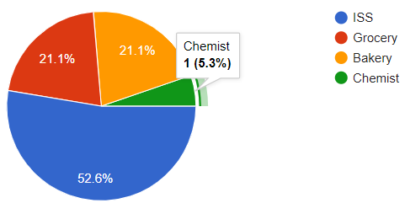
DATA ANALYSIS
Que.1: What type of outlet is this?
Analysis:
As per the Table No.1 respondents were asked that which type of outlet was that? where 52% were ISS stores, 21.1% Grocery & Bakery respectively & 1% Chemist.

Slide 11
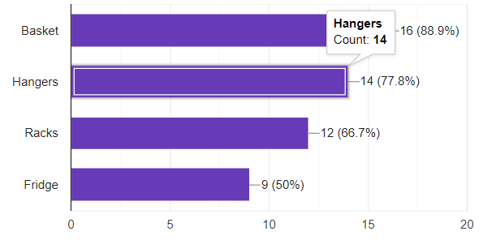
Que.2: What does companies offers you with their product?
Analysis:
As per the Table No.8 respondents were asked that, what does companies offer them with their products?
Where 88.9% of outlets are offered basket with product, secondly with 77.8% hangers are offered, thirdly with 66.7% racks are offered & lastly with 50% fridge are offered.

Slide 12
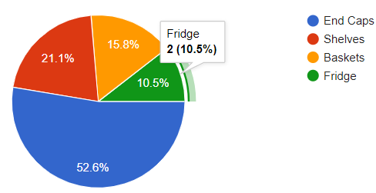
Que.4: On what basis the pay-outs have been given to you?
Analysis:
As per the Table No.6 respondents were asked that, on what basis the pay-outs have been given to them?
Where 52.6% of outlets gets playouts on the basis of End caps, 21.1% gets pay-outs on the basis of Shelves, 15.8% on the basis of Baskets & 10.5% on the basis of Fridge.

Slide 13
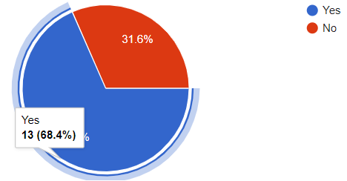
Que.5: Is any special scheme/ pay-outs given by companies to you?
Analysis:
As per the Table No.11 respondents were asked that, is any special schemes/ pay-outs given by the companies to them?
Where 68.4% of the top outlets said Yes on the other hand 31.6% of the top outlets said No.

Slide 14
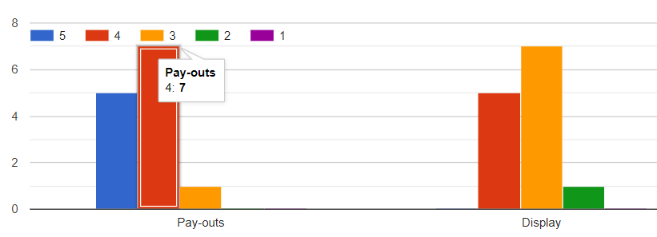
Que.6: If “Yes” how will you rate them?
Analysis:
As per the Table No.12 respondents were asked that, if they are getting special scheme from any company then how they will rate it on the basis of Pay-outs & Display?
Where for Pay-outs: 5 outlets rated 5 points, 6 outlets rated 4 points & 1outlet rated 3 points.
For Display: 0 outlet rated 5 points, 5 outlets rated 4 points, 6 outlets rated 3 points & 1 outlets rated 2 points.

Slide 15
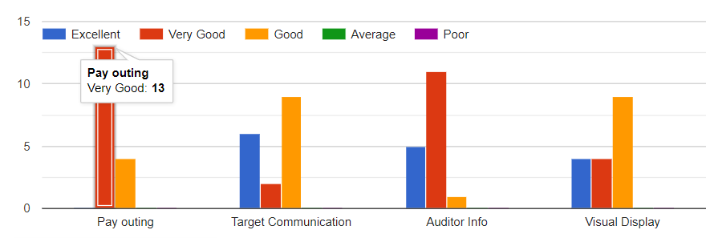
Que.7: Rate ITCs schemes based on following parameters:
Analysis:
As per the Table No.13 respondents were asked that, how will they rate ITCs schemes on the basis of Pay-outs, Target Communication, Auditor Info & Visual Display.
For Pay-outs: 13 outlets Rated Very Good & 4 rated Good, for Target Communication: 6 outlets rated excellent, 2 outlets rated Very good & 9 outlets rated good, For Auditor Info: 5 outlets rated excellent, 11 outlets rated very good & 1 outlets rated good, For Visual Display: 4 outlets rated Excellent, 4 outlets rated very good & 9 outlets rated good.

Slide 16
FINDINGS
Maximum companies have offered these outlets Baskets with 89% of them aggreging on it.
Almost 53% of top outlets gets the pay-outs for companies on End Caps which is maximum since most of the outlets are ISS stores in top outlet programs.
Almost 68% of the top outlets get special schemes from company meanly Parle. Where parle provides good schemes/pay-outs but haven’t focus on display.
Top outlets were told to rated ITC on the basis of Pay-outing, target communication, auditor info & visual display. Maximum outlets voted more for pay-outing, secondly for auditor info, thirdly for target communication & lastly visual display.

Slide 17
CONCLUSION
Through the project repost researcher came to know that display advertising is carried on in these top outlets in the form of hoardings, Stickers & indirectly through product offerings by most of the companies.
Through this project report researcher came to know what competition is driven by different companies in top outlets in Shrirampur region. Thus, through research, researcher came to know that for making product sale companies tried to provide monthly incentives, pay-outs, product offerings, special schemes etc.
Company like Parle which does not provide any sort of pay-outing to top outlets like other companies such as ITC, Britannia, Nestle & HUL does. But Parle provide some special schemes to these top outlets so that they can earn good margin & company can able to increase sale.

Slide 18
Companies do provide product offerings like Hangers, Baskets, Racks, Fridge etc to these top outlet stores as a compliment for their performance. Which also motivates these outlets to perform their best for achieving the targets.
On analysing top outlets perception towards ITCs schemes provided to them on the basis of Pay-outing, target communication, Auditor Info & Visual Display. Top outlets rated pay-outing the most Auditor info is secondly rated then target communication & visual display

Slide 19
SUGGESTIONS
Target communication is where ITC should look to improve except ISS outlets, most outlets like grocery & bakery are unaware of what are the targets given to them.
Visual display is playing vital role in advertisement or marketing of product thus increment in visual display in top outlets can improve sales.
Through interviewing the owners of top outlets researcher came to know that they are preferring bill cutting more than that of bank transfer for pay-outing coz., according to them it helps to be aware bout pay-out as its available on bill itself.
ITC should not focus on SMS as a mode of target communication but should go with WhatsApp as owners are quite active on that mode which will help in making awareness about monthly targets. Since its untapped

